Slide 1
Advanced Data Structure and Algorithms
Trees
Graphs
Hashing
Search trees, Indexing, and multiways trees
File Organization

Slide 2
UNIT 4 SEARCH TREES, INDEXING, MULTIWAY TREES

Slide 3
Contents
Symbol Table
Representation
Static & Dynamic tree table
Introduction to Dynamic Programming
Weight balanced tree
Optimal Binary Search Tree (OBST)
Height Balanced Tree- AVL tree.
Indexing and Multiway Trees
Indexing
B-Trees, B+Tree, Trie Tree, Splay Tree, Red-Black Tree, K-dimensional tree
Heap Operations
Heap as Priority queue
Heap Sort

Slide 4

Symbol Table
Symbol table is an important data structure defined as the set of <Name, Value> pairs.
Operations or Functions of symbol table :
create() : symbol_table
destroy() : symbol_table
enter (name, value) : pointer to an entry
find (name, table) : pointer to an entry
set_attributes (*entry, attributes)
get_attributes (*entry) : attributes

Slide 5
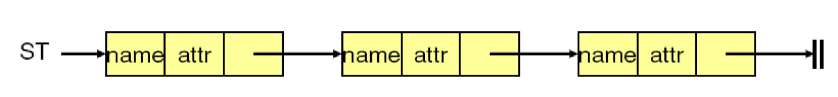
Symbol Table – Implementation techniques
Basic Operations : enter() and find()
Considerations:
Number of names
Storage space
Retrieval time
Organizations:
Unordered List - (linked list/array)
Ordered List – Binary search on arrays
Binary Search Trees
Hash Tables – Most common approach (constant time)

Slide 6
Use of symbol table
A data structure used by a language translator such as a compiler or interpreter.
Where, each symbol in a program's source code is associated with information relating to its –
Declaration
Scope or appearance in the source
Store information about the occurrence of various entities such as variable names, function names, objects, classes, interfaces, etc.
COMPILER
Source Program
Target Program
Errors

Slide 7
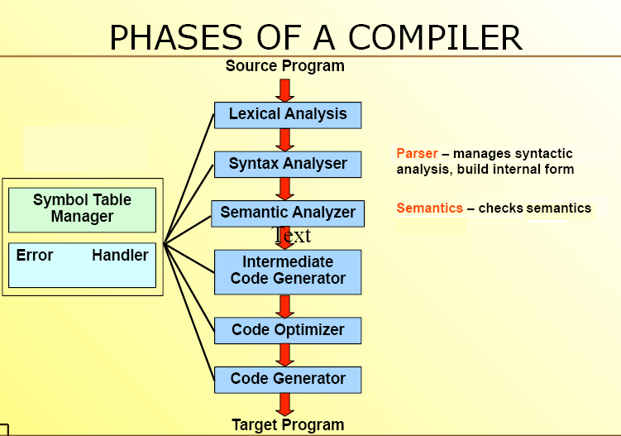

Slide 8
Lexical Analyzer
Lexical Analyzer converts sequence of characters into a sequence of tokens.
A token describes a pattern of characters having same meaning in the source program.
(such as identifiers, operators, keywords, numbers, delimeters and so on)
Puts information about identifiers into the symbol table.
Ex: newval = oldval + 12 → tokens:
newval identifier
= assignment operator
oldval identifier
+ add operator
12 a number

Slide 9
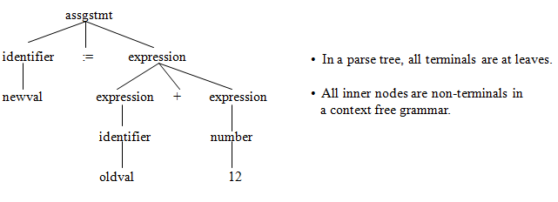
Syntax Analyzer
A Syntax Analyzer creates the syntactic structure (generally a parse tree) of the given program.
A syntax analyzer is also called as a parser.
A parse tree describes a syntactic structure.

Slide 10
Semantic Analyzer
A semantic analyzer checks the source program for semantic errors and collects the type information for the code generation.
Type-checking is an important part of semantic analyzer.
Ex:
newval := oldval + 12
The type of the identifier newval must match with type of the expression (oldval+12)

Slide 11
Intermediate Code Generation
A compiler may produce an explicit intermediate codes representing the source program.
These intermediate codes are generally machine (architecture independent).
Ex:
newval := oldval * fact + 1
id1 := id2 * id3 + 1
MULT id2, id3, temp1
ADD temp1, #1, temp2
MOV temp2, id1

Slide 12
Code Optimizer (for Intermediate Code Generator)
The code optimizer optimizes the code produced by the intermediate code generator in the terms of time and space.
Ex:
MULT id2,id3,temp1
ADD temp1,#1,id1

Slide 13
Code Generator
Produces the target language in a specific architecture.
The target program is normally is a relocatable object file containing the machine codes.
Ex:
MOVE id2,R1
MULT id3,R1
ADD #1,R1
MOVE R1,id1

